Slide 1



Video Game Success Model
Rebecca Solomon, Isabel Sy, Mustafa Naeem, Matheus Araujo & Sabrina Fernandez

Slide 2


A Short History on Video Games
1958
1990
2010
PRESENT
Tennis for Two!, the very first video game, was created!
3D Graphics and home console boom
Diversity in genres and mobile game boom
Photorealistic graphics and complex stories

Slide 3
THE BIG QUESTIONS
1
DEMOGRAPHICS
Who is playing video games?
2
CULTURE
What video game genres are popular in different parts of the world?
3
FUTURE
Where is the video game market heading?
Notes:
The history of video games began in the 1950s and 1960s as computer scientists began designing simple games and simulations on minicomputers and mainframes.
Timeline of video games:
It’s debatable as to what exactly the first video game was, but it’s been condensed to 2: Tennis for Two in 1958 and SpaceWar! In 1960.
1960s to 1980’s - video games were created to test computer programs. This was a big deal back then, because it was when computers first started getting developed. By the 70’s, video games were ready to be sold to bring home to families. Magnavox Odyssey was the first home console created (not even known at this point). By the 80’s, video games were a massive hit. We were introduced to the “Golden Age” of video games with the likes of Pac-Man and Space Invaders. This is also when American companies began losing sales due to cheap production of games with poor quality (which caused Japan to step up and start competing in the market with Nintendo).
1990’s to 2010’s - innovation really shined during the 90’s. We were first introduced to FPS games, strategy games, and 3D graphics. Arcade games declined, but home games got a huge hit (Sony’s Playstation and GameCubes). By the 2000’s, more genres were added like music games (Guitar Hero) and role-play games like Animal Crossing. This was also when MOBILE GAMES became a huge thing, especially for Asia. By the 2010’s, more controllers and consoles were added for all major companies such as Xbox 360 and Nintendo Wiis.
2010 to present - As video games move forward closer to the present, modern games now are a lot more lifelike than their older counterparts. There are a lot of photorealistic graphics now and a lot of the popular games usually focus on teamwork based strategy games or action games with complex stories in them.
1990’s to 2010’s - innovation really shined during the 90’s. We were first introduced to FPS games, strategy games, and 3D graphics. Arcade games declined, but home games got a huge hit (Sony’s Playstation and GameCubes). By the 2000’s, more genres were added like music games (Guitar Hero) and role-play games like Animal Crossing. This was also when MOBILE GAMES became a huge thing, especially for Asia. By the 2010’s, more controllers and consoles were added for all major companies such as Xbox 360 and Nintendo Wiis.
2010 to present - As video games move forward closer to the present, modern games now are a lot more lifelike than their older counterparts. There are a lot of photorealistic graphics now and a lot of the popular games usually focus on teamwork based strategy games or action games with complex stories in them.

Slide 4
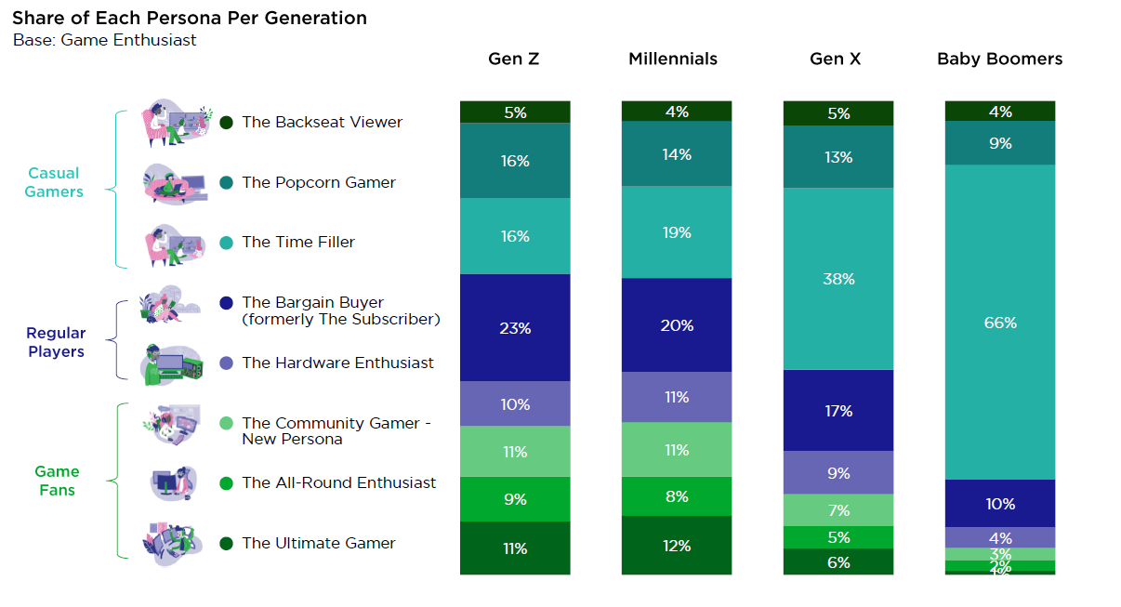
Types of Gamers
Notes:
Based on this graph, we can see the older generations such as Baby Boomers and Gen X-ers are more “casual gamers”, with 66% of Baby Boomers and 38% of Gen X-ers compared to the 19% and 16% of millennials and Gen Z-ers. As we move further below though, it’s clear that more Millennials and Gen Z-ers are regular players and game fans compared to their older counterparts.

Slide 5
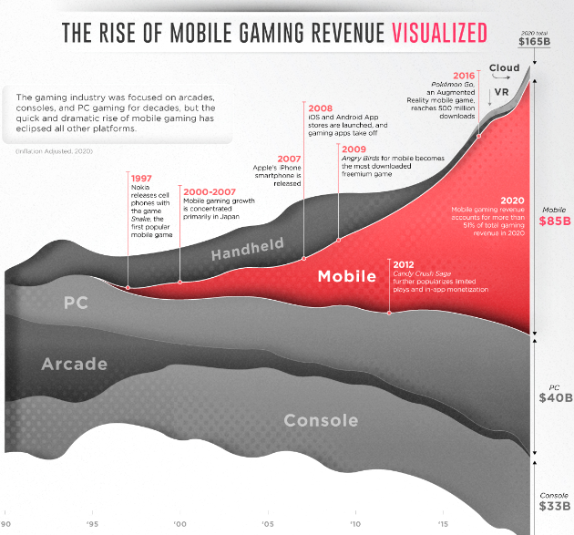
Rebecca Solomon's Zoom Meeting
MOBILE GAMES:
1997 - First Mobile Game - SNAKE
2020 - Mobile Game Over 51% of total VG Rev
Notes:
https://www.visualcapitalist.com/50-years-gaming-history-revenue-stream/

Slide 6
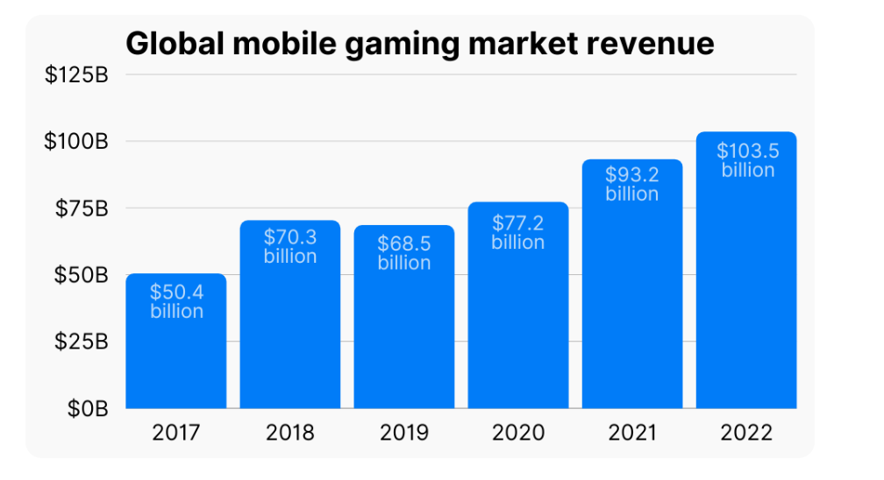
105%

Slide 7
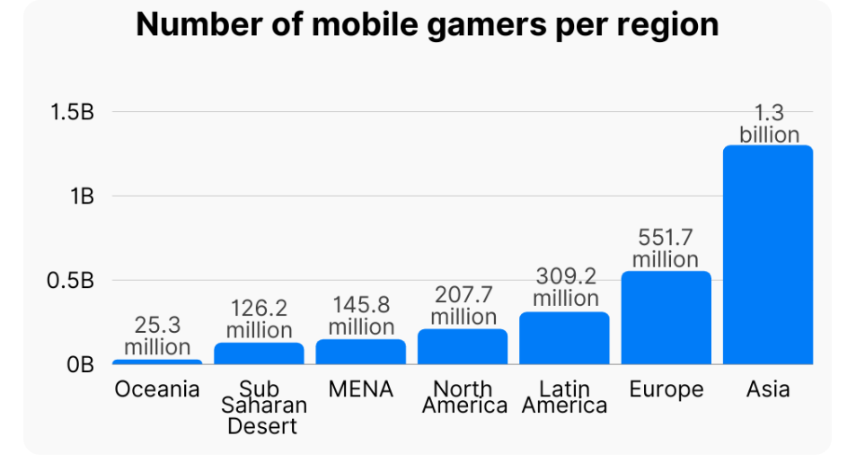
550%
160%

Slide 8


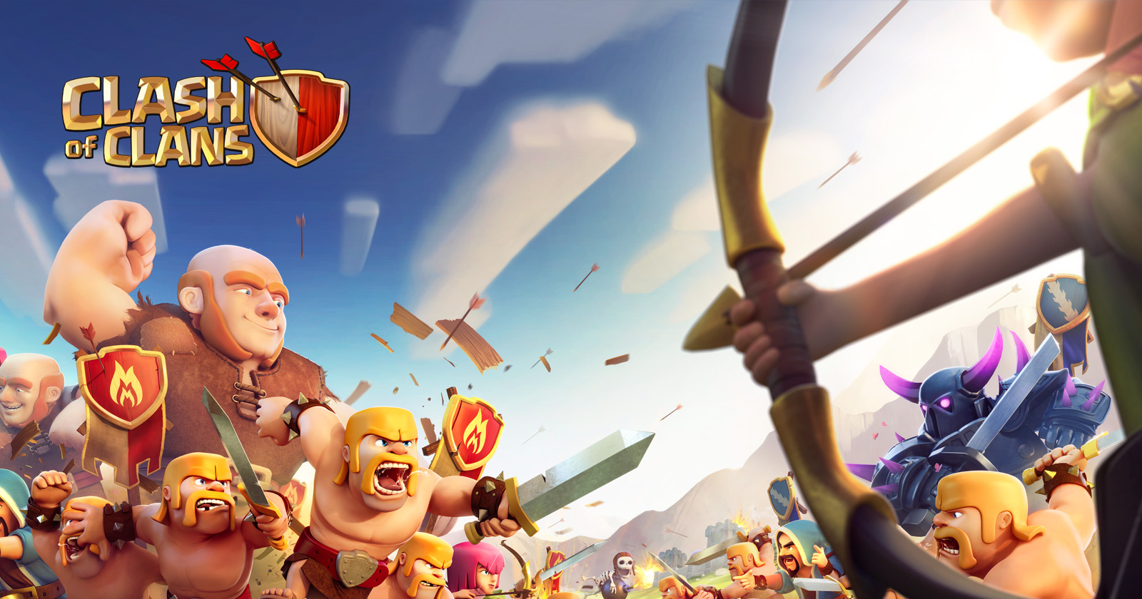
Mobile Games in Asia
Largest revenue for Japan is from mobile games. - source
82% of Southeast Asia’s population are gamers. - source
Free-to-play option is the primary driver for mobile gaming in Asia.
Notes:
Over 82% of Southeast Asia's urban online population is a gamer, and mobile gaming outnumbers PC and console games by a wide margin. - https://www.globenewswire.com/en/news-release/2023/04/25/2653602/28124/en/Southeast-Asia-Gaming-Market-Report-2023-Rising-Popularity-of-Smartphones-and-5G-Technology-is-Expected-to-Boost-Growth.html#:~:text=Over%2082%25%20of%20Southeast%20Asia's,games%20by%20a%20wide%20margin.
Malaysia, Thailand, Vietnam, Indonesia, Singapore, and the Philippines are Southeast Asia's six most important mobile gaming markets.
The availability of a free-to-play option is one of the primary drivers of mobile gaming when compared to personal computers. The introduction of cloud-based mobile gaming may accelerate this trend. – a big contributor as to why mobile games are so popular in Asia is due to financial constraints!

Slide 9
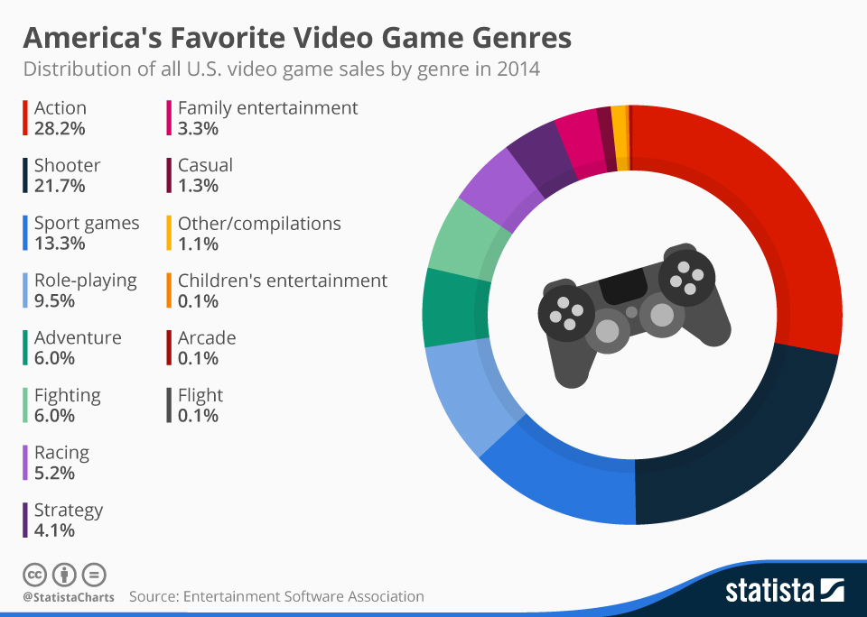
2014
Top 5
Action
Shooter
Sport
RP
Adventure
Notes:
100% distribution

Slide 10
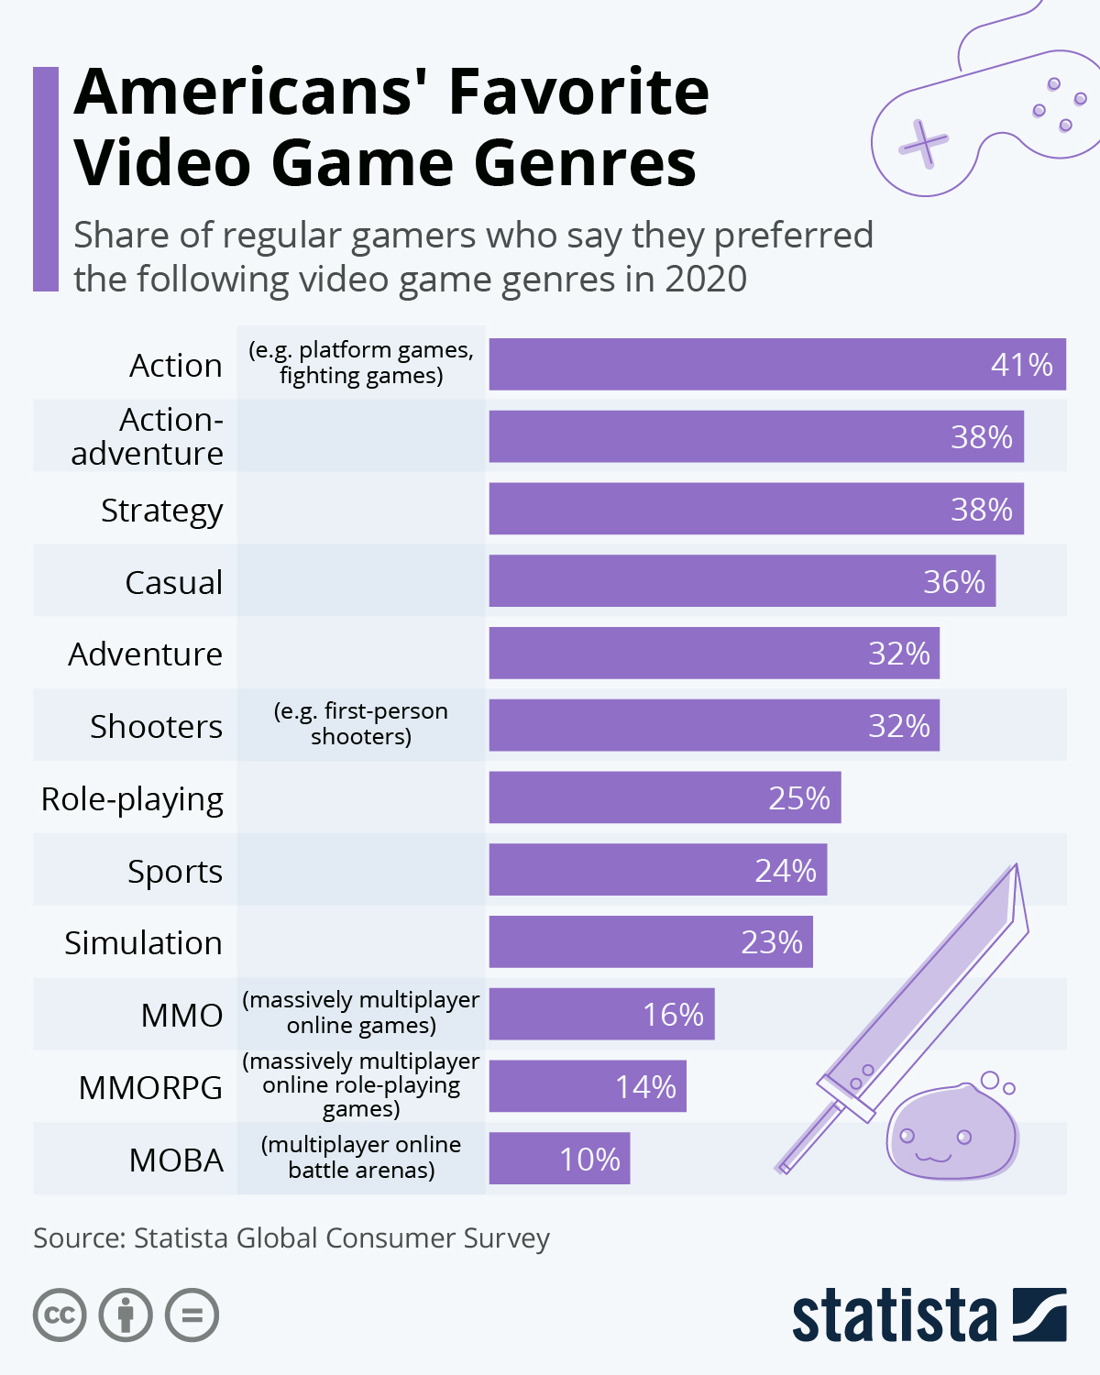
2020
Top 5
Action
Action-Adventure
Strategy
Casual
Adventure
Notes:
New game categories
MMO
MMORPG
MOBA
Not 100% distribution

Slide 11
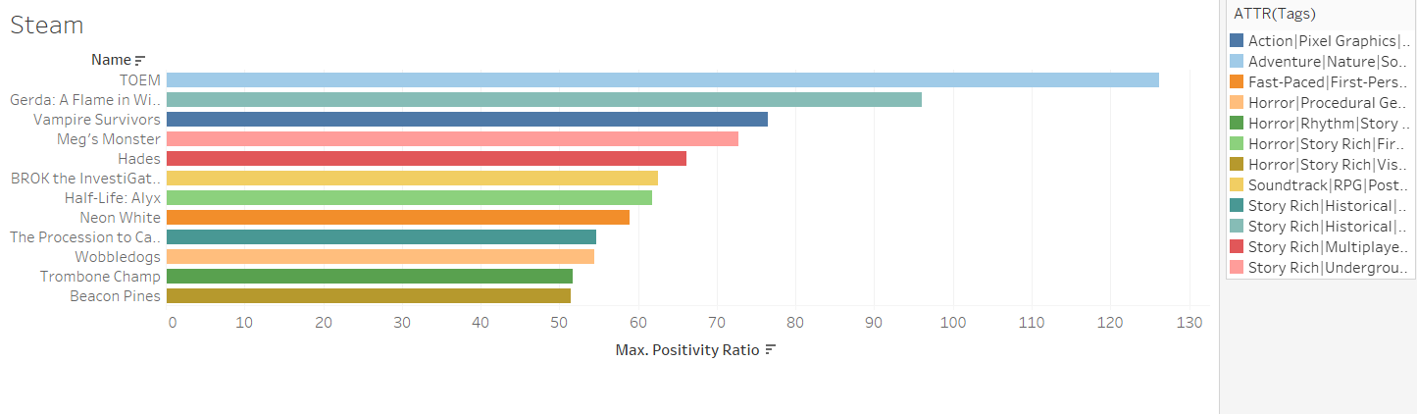
Positivity Ratio
Notes:
In terms of figuring out which parts of the game developers can improve on, according to this Steam game positivity ratio, the most positive reviews can be summarized into these categories: good graphics, unique character design, rich storyline, and average difficulty. - https://data.world/crawlfeeds/gamestop-products-reviews-dataset

Slide 12



Model Goal:
To predict the success of different video game genres in certain regions.
Notes:
To predict the success of game genres in certain regions in order to maximize profit and develop better marketing strategies for future games. The regions we chose are North America, Europe, Japan, Global, and Other countries that were not aforementioned.

Slide 13
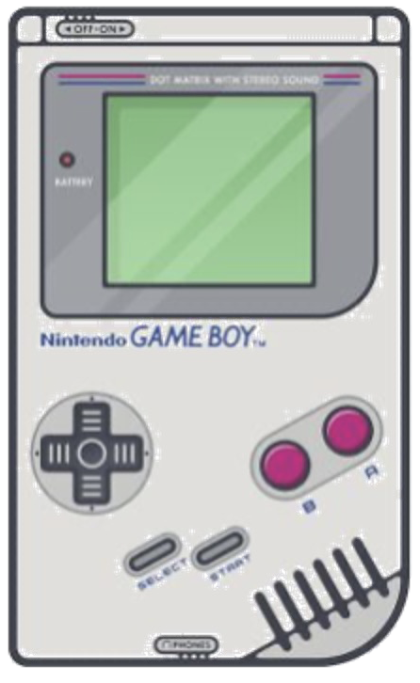

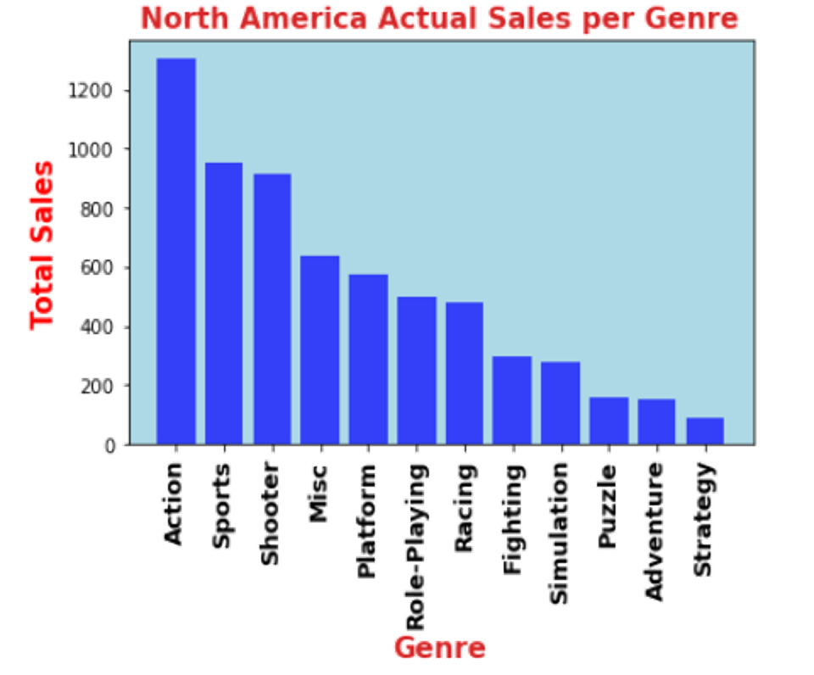
Best Selling:
North America
Action
Sports
Shooters
Notes:
The best selling video game genre for North America is Action.

Slide 14

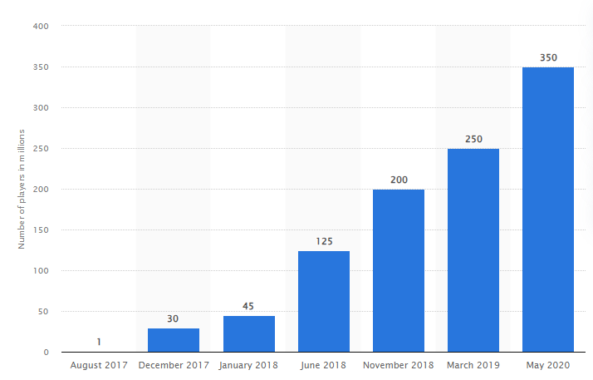
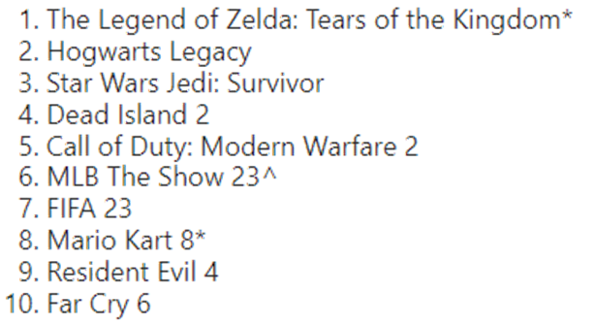
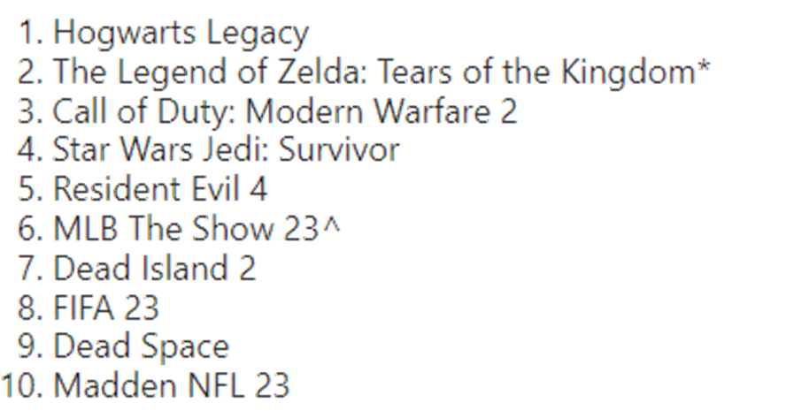
40%
US Best Selling Sales in May 2023
US Best Selling Sales to date

Slide 15
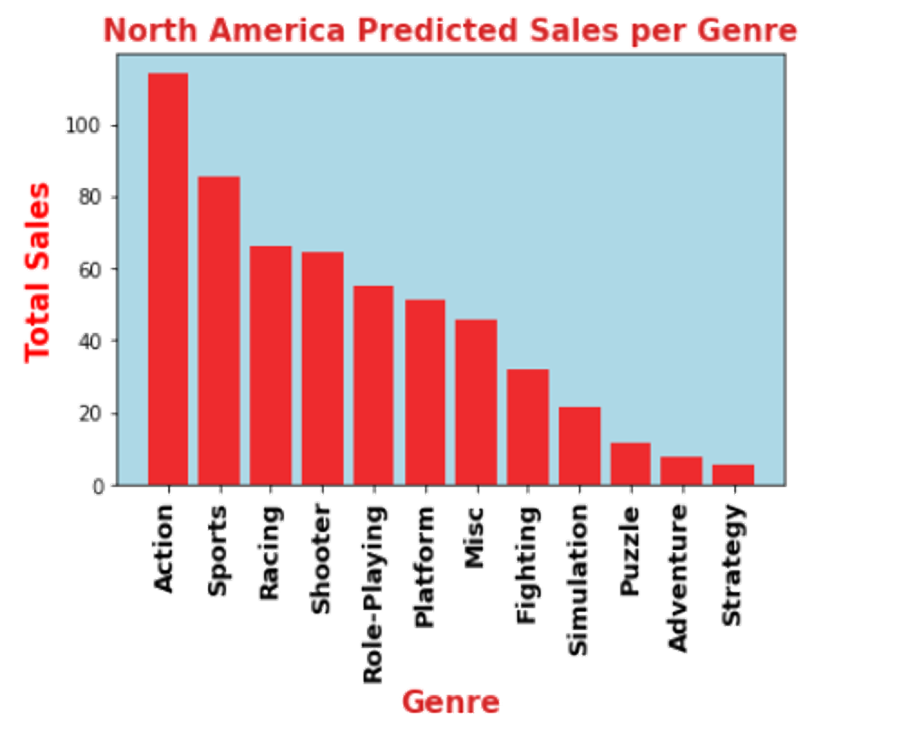
North America Sales
Actual
Predicted
-1
+1
+1
+4
+1
Notes:
Top and bottom genres stayed the same on actual and predicted, it’s mostly the middle genres that changed.
The only thing the graph is telling us is the popularity of the genres, we can ignore the sales because we can feed more data into the model as we continue on.

Slide 16
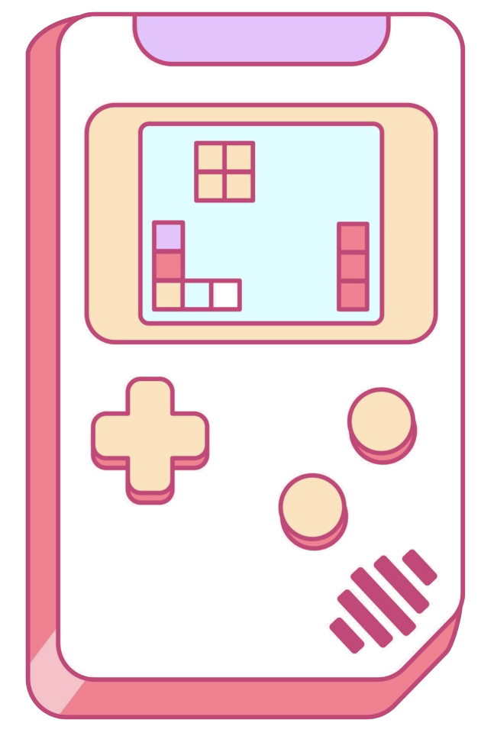

Best Selling:
Europe
Action
Sports
Shooter

Slide 17
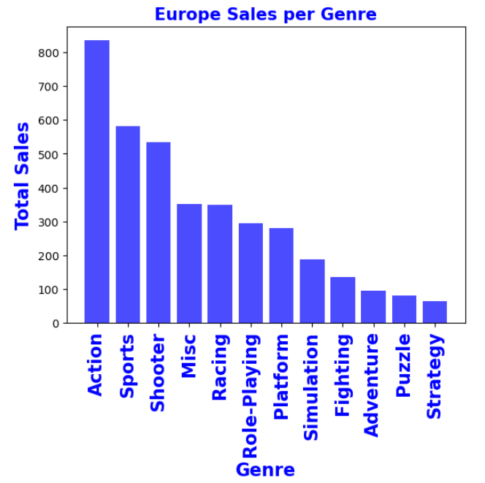
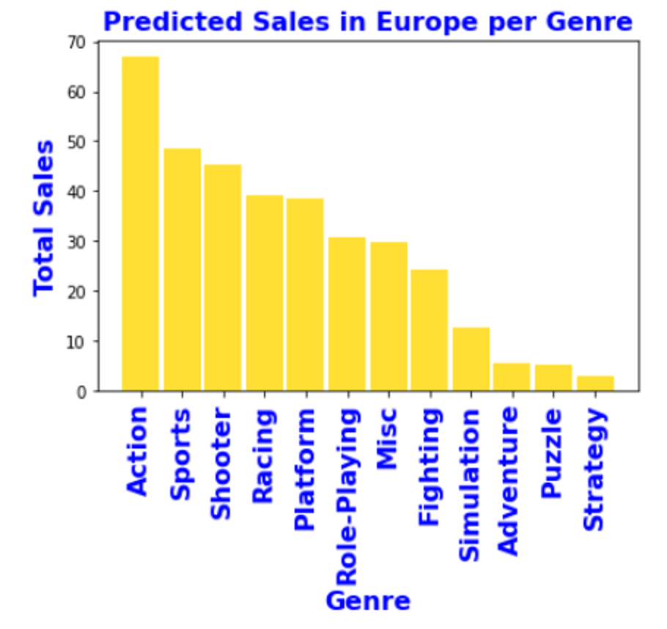
Europe Sales
Actual
Predicted
+1
+2
+2
Notes:
Top and bottom genres stayed the same on actual and predicted, it’s mostly the middle genres that changed.

Slide 18


Best Selling:
Japan
Role-Playing
Action
Platform
Notes:
So now we’re moving into Japan, for Japan the top selling genre are role-playing games (RPG). On the next slide, we can clearly see on the graphs the popularity of this genre…

Slide 19
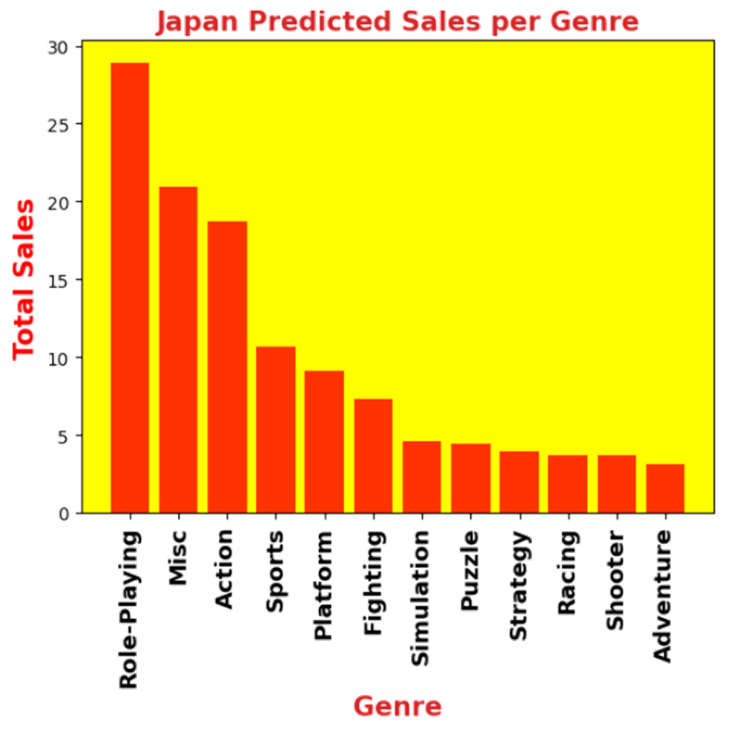
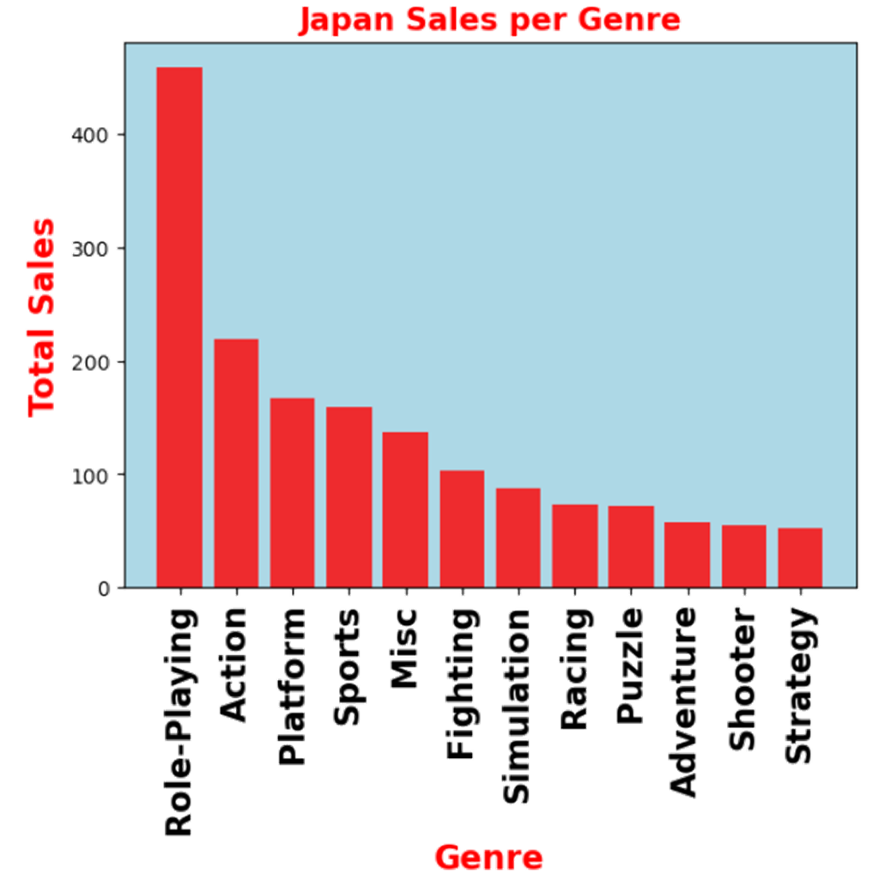
Japan Sales
Actual
Predicted
-1
-2
-2
-2
-3
Notes:
For the actual popularity, role-playing is definitely number 1 with a big difference between that and miscellaneous. (discuss the difference between the middle genres moving and how adventure moved to the bottom, HOWEVER, role-playing stays the most popular genre at number one…. WHY IS THAT? (next slide)

Slide 20


21,881
Possible Reasons:
Japan’s history with RPG games. - source
Karoshi culture in Japan and escapism. - source
Confirmed suicide cases in Japan in 2022. - source
Notes:
Possible reasons:
Japan has the second highest suicide rate in relation to overworking in the world, only recently topped by Korea (https://www.statista.com/statistics/622325/japan-work-related-suicides/): Karoshi culture in Japan (Karoshi culture is the culture of working extremely long hours, as doing less is deemed lazy or disrespectful). - RPGs provide an escape from reality and an illusion of control (when people can’t control their own lives, they find another outlet for control such as video games).
Japan has a long history with RPGs. Their first released RPG was in 1982 and continues to make more money for the economy as time goes on. One notable game that racked in international success is the Final Fantasy Series. - https://en.wikipedia.org/wiki/History_of_Eastern_role-playing_video_games#:~:text=Japan's%20earliest%20RPGs%20were%20released,with%20a%20modern%20espionage%20setting.
https://osgamers.com/frequently-asked-questions/why-are-rpgs-so-popular-in-japan#:~:text=There%20are%20many%20reasons%20why,continue%20to%20perpetuate%20the%20cycle.
The number of suicides in Japan in 2022 totaled 21,881, an increase of 297 from the previous year. By cause or motive, “health issues” was most common, as a contributing factor in 12,774 suicides, followed by “family issues” (4,775 suicides), and “economic/livelihood issues” (4,697 suicides). - https://www.nippon.com/en/japan-data/h01624/#:~:text=The%20number%20of%20suicides%20in,from%20the%20National%20Police%20Agency.

Slide 21
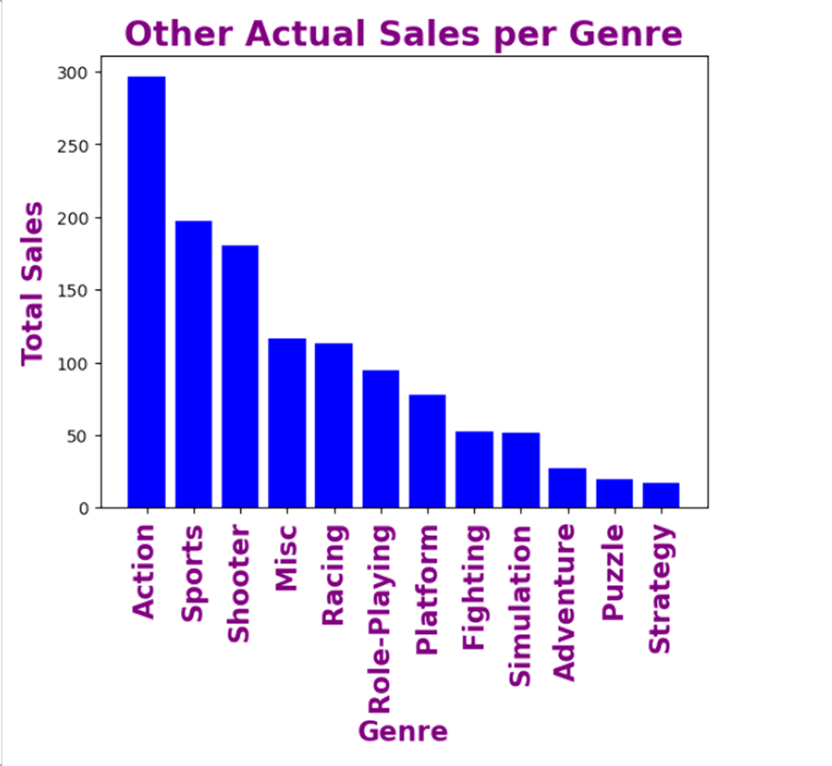
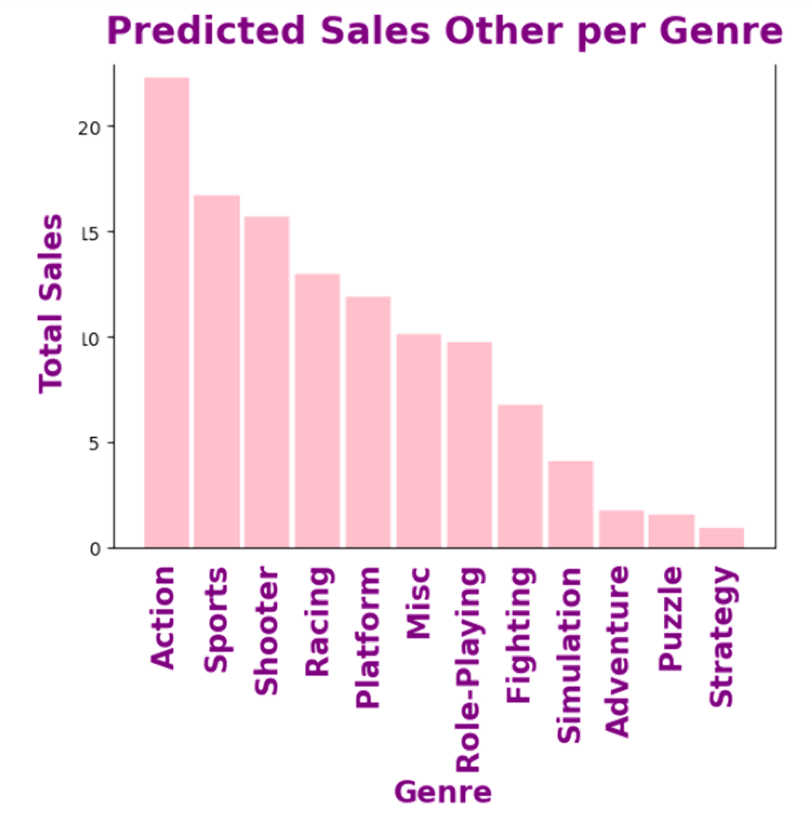
Rest of the World
Actual
Predicted
-1
+2
Notes:
For the rest of the world, action still remains the most popular genre with strategy games as the least popular in both the actual graphs and the predicted graphs. The only difference are: RPG went down 1 and Platform moved up 2 spots.

Slide 22
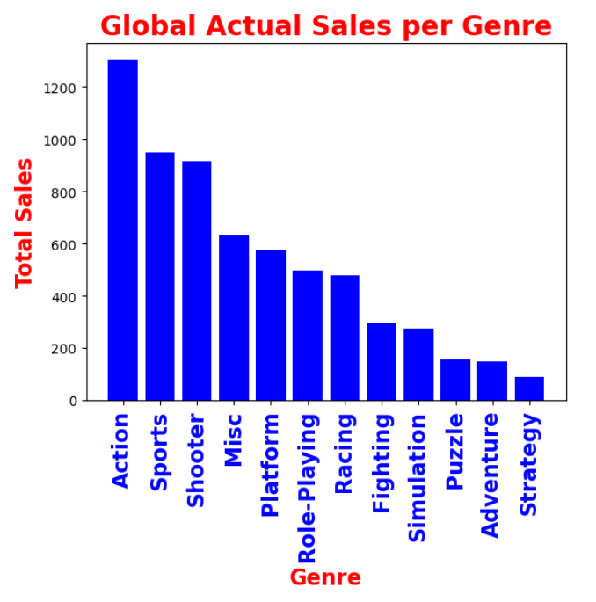
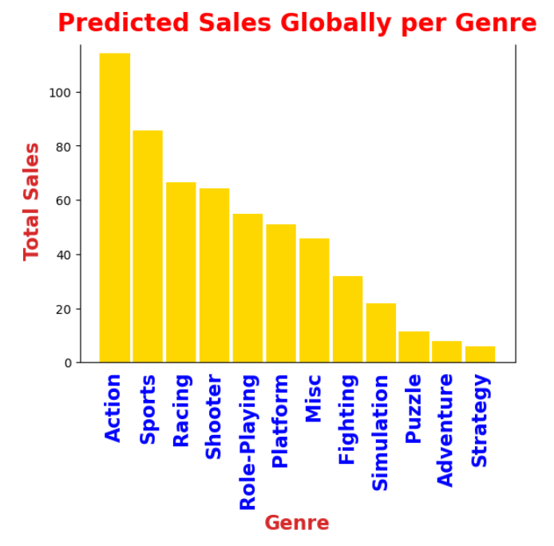
Global Sales
Actual
Predicted
+4
Notes:
Same with global sales: action is still on top with strategy on the bottom, with RPGs moving 4 spots up in the predicted graph. So from this, we look into the actual reviews FROM gamers… (NEXT SLIDE, TALK ABOUT STEAM AND POSITIVITY RATIO).

Slide 23
WHY?
FOR DEVELOPERS
Increased profits and job opportunities
Foot-in-the-door for indie developers
Better marketing for future games

Slide 24
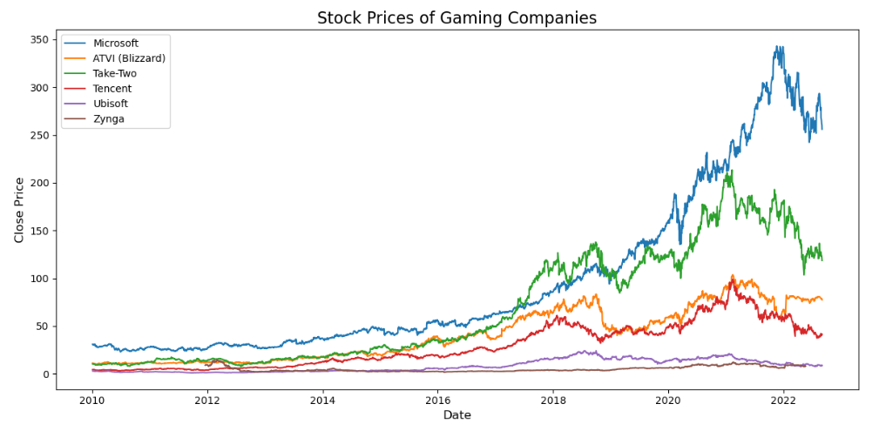
Notes:
Explain that the user can input specific dates they would want the model to predict in. In this example, it’s more just to show that the model is accurate in predicting the genres for the games in North America.

Slide 25






Game Developers

Slide 26

CONCLUSION:
Our AI model is profitable for game developers.
graphics, character design, storyline, & difficulty
Action is the leading genre across all regions.

Slide 27

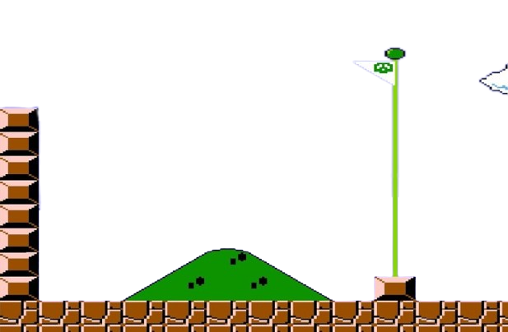
Notes:
Insert Among Us picture here :p

